Slide 1

The Unreasonable Effectiveness of Data: A Scalable Framework for “Understanding” Social Forums and Discussions
Vwani Roychowdhury
Department of Electrical and Computer Engineering , UCLA
Notes:
Hello everyone
Thank you very much for coming.
I am here to present an automated and scalable story analysis and detection framework from social media called Strands.

Slide 2
Joint Work with ….....
Tim Tangherlini, Misagh Falahi, Ehsan Ebrahimzadeh, Behnam Shahbazi, Roja Bandari, countless other students and collaborators ….....
Notes:
Hi everyone, my name is Zicong. Thank you all for coming to my thesis talk. The title of my thesis is Information dynamics in social interactions: hidden structure discovery and empirical case studies.

Slide 3
The Alien’s Human Problem
Petabytes of microscopic-scale data collected at the user level, comprising user clicks, posts, searches, shared content etc.
Analogous to the natural sciences: To come up with models at any scale, we find ways to measure collective and average quantities.
So we need to develop measurement devices that capture the macroscopic structures in the data to find what features are interesting and then develop models of how they may have emerged.
Notes:
Hi everyone, my name is Zicong. Thank you all for coming to my thesis talk. The title of my thesis is Information dynamics in social interactions: hidden structure discovery and empirical case studies.

Slide 4
What are macroscopic structures?
Distinct Probability Distributions over a multidimensional feature space that are significantly different from random structures.
Potentially time varying, but with temporal persistence.
Akin to Non-equilibrium Structures, such as Solitons, Turing Structures, and Swarms.
These structures are driven by external energy sources, and are succinctly described as specific probability distributions over the observables, e.g., a swarm is a distribution over the position and velocity of the birds.
Notes:
Hi everyone, my name is Zicong. Thank you all for coming to my thesis talk. The title of my thesis is Information dynamics in social interactions: hidden structure discovery and empirical case studies.

Slide 5
Concluding Thoughts
We need models and computational tools to be able to send machines to school.
A platform for Perpetual Learning.
Seeded with “humanness” models, it should be able to learn contextually and persistently.

Slide 6
Gestalt Computing and the Study of Content-Oriented User Behavior on the Web
Joint Work with
Roja Bandari

Slide 7
Focus of Talk
Content-oriented collective behavior
Collective behavior: different meanings across many traditions.
Here we use it in a general sense: attitudes and actions of groups of users
Content-oriented: involving users’ creation, sharing, and promotion of content and their attitudes toward content (text or other material)
Based on elementary user actions on the web
Earlier work:
Cascades of crisis-reporting in Twitter
Prediction of news article popularity in Twitter
A study of topics and communities in a parenting forum
Bulk of talk: Evolving groups in social news
Notes:
The focus of this talk is content oriented collective behavior.
.
.
.
For the bulk of the talk, we’ll go through a study of evolving groups in social news.
Now I will go into the spec

Slide 8
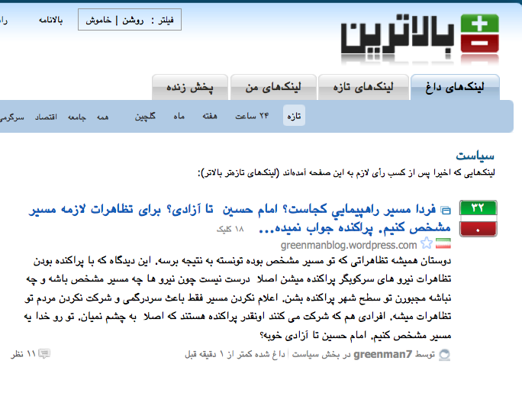
Social News
Social news aggregation sites have article submission, voting, and commenting capabilities
Examples: Reddit, Digg, Slashdot, Balatarin
Notes:
Social news website, or social news aggregation websites are online spaces where users can post articles, promote articles, or comment on articles.

Slide 9
Motivating Questions
How would one begin to understand the user population?
Critical for websites that rely on user participation.
Interesting to researchers in computational social science.
Once we have this, we can answer other questions:
What are the evolving interest patterns?
Do users form polarized and insular groups?
Does one group dominate or drive out other groups?
How do external events affect these dynamics?
Debates about capabilities of the web for civic participation
Notes:
So the question we would like to ask about these websites is: how can we understand the user population?

Slide 10
What are some approaches?
Simple questions:
What are most popular articles?
Who are the most active users?
Predictions of popularity of an article
Content-Based methods:
Sentiment analysis → in articles with a keyword (e.g. USA)
Topic modeling: what topics are being discussed
Computationally intensive
These methods neither sketch a complete overall picture nor lay out a path to investigate the whole picture.
Notes:
Replace with how could we do this but they won’t provide this. Time evolution,

Slide 11
Dataset and Methodology
Balatarin: popular Persian-language social news site
4 years of data: users, articles, and user votes to articles
Politics Category: 26,000 users 350,000 articles, 9.2M votes
Votes: elementary user actions
Explicit indicators of user preference for content
Other examples: Like (Facebook), up-vote (Reddit), +1 (G+), Digg
Detect communities of users with similar voting patterns and track these communities' temporal evolution.
Characterize evolving communities through their preferred content
Notes:
Our data set includes…
.
.
We will explain each of these steps in more detail in the coming slides.

Slide 12
Methodology
Divide data into periods
Detect user communities in each period
Map consecutive communities
Extract representative articles
Extract representative terms and domains
Divide data into consecutive overlapping time periods (30 days, 14 day overlap).
Time = t₁
C₁
C₂
C₃
Path summary:
Representative Domains
Representative Words
Time = t₂
C₁
C₂
Time = t₃
C₁
C₂
Notes:
We will first divide the data into several overlapping time periods. We chose each time window to be 30 days and then shift this window by 14days.
Users in each community will have similar taste in articles.
.
.
So this is the overall process.

Slide 13
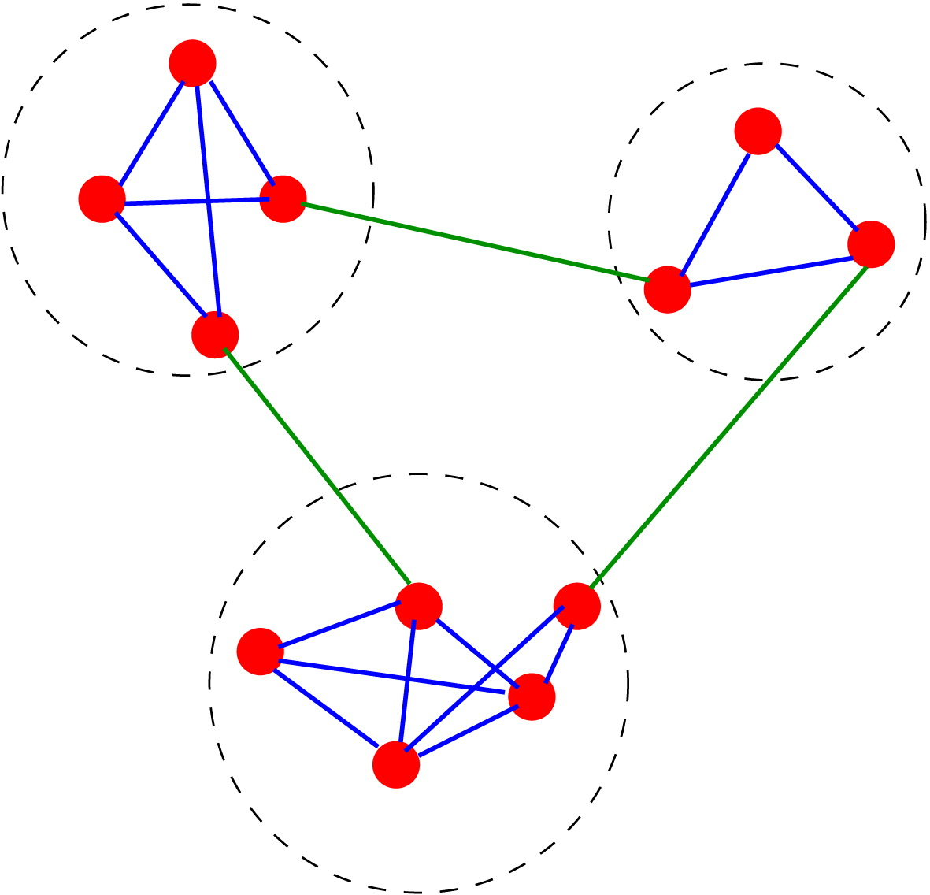
Communities
Higher density of edges within communities than between them
Modularity* = fraction of edges that belong to the same community in the graph minus the null model
Null model:
Graph with same degree sequence
Connect pairs of edge stubs (2m) at random
Optimize by iteratively joining communities, starting with single-node communities.
Communities that vertices x and y belong to
Number of edges in the graph
k_{y} = 6
k_{x} = 3
* Developed by Girvan, Clauset, Newman
Notes:
Now in order to find communities of users, we will use a network-based definition of communities.
Considering groups of users in a graph, a community has the property that ….
One of the most popular measures of quality of communities is Modularity (developed by Girvan and Newman).
It computes the fraction of edges that belong to the same community, but if you only consider this, it will not be a good measure since placing all the nodes in one community gives perfect results but is completely useless. So the metric compares this fraction with its expected value in a null model.
high mod → good community
Sparse graph: m(edges) ~ n(vertices)
Inter-cluster density

Slide 14
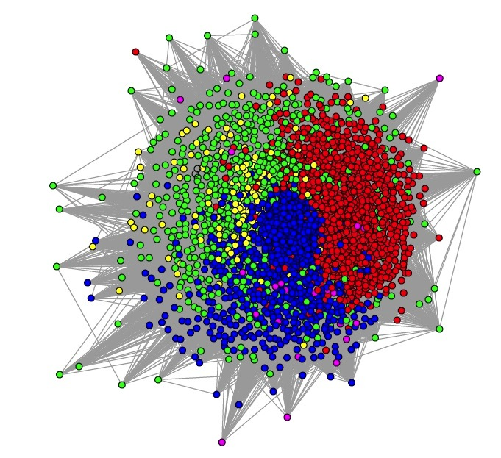
Bipartite Projection
In each time period votes create a bipartite graph of articles and users
Project to a weighted unipartite network
Weight between users x and y
X: set of articles voted for by user x
Y: set of articles voted for by user y
n: set cardinality
Notes:
In our dataset, we can define a bipartite graph of users and articles where vote connects a user to an article.
We project this onto a weighted bipartite graph of users.
Define weights in graph of users based on similarity of content preference.
Perform modularity-based community detection

Slide 15
Detect and Map Communities
For a weighted graph
Replace A_{xy} with W_{xy} and m with total weight in the graph, W.
Replace vertex degree k_{x} with vertex strength s_{x}
Communities reflect users with similar content preference
Map consecutive communities based on user overlaps.
Time = t₁
C_{i}
Users in community i
0.5
0.04
.
Time = t₂
C_{j}
C_{k}
Notes:
In order to find communities in a weighted graph, the modularity expression can be modified by …
We then map communities in consecutive time windows based on user overlaps.

Slide 16
Define an Evolution Path
Define a path as consecutive mapping of communities with no merges or splits lasting a minimum duration (at least 3 months long)
Size of each oval represents size of community
1 month
Time = t₁
C₁
C₂
C₃
Time = t₂
C₁
C₂
Time = t₃
C₁
C₂
Notes:
Once we have the communities mapped over all time periods, we find strings of communities that form a path.
Size Scales with the square root of number of users

Slide 17
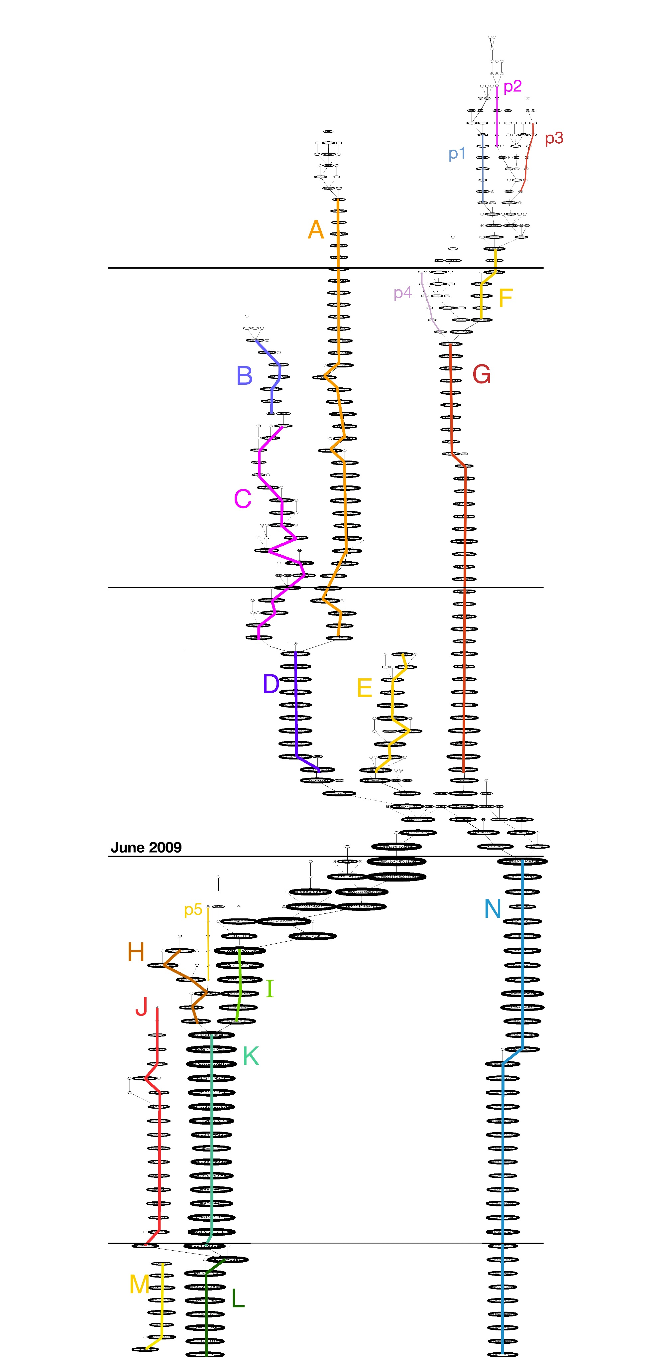

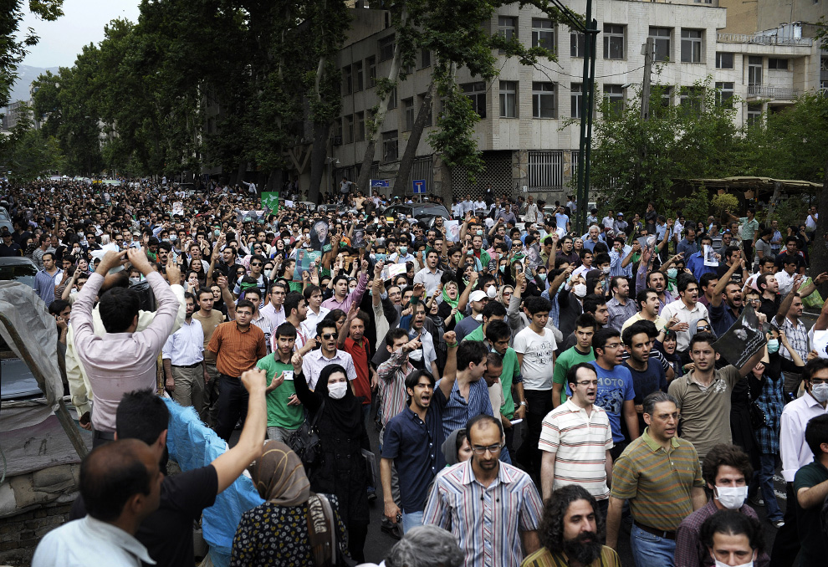
June 2009
Time
Notes:
here is the result of applying this process to the whole dataset.
Time begins from the top in 2006.
We see several communities that form and evolve over time by joining and splitting.
We also observe: Significant increase in size, shuffling and disorganization
At this point there are no methods out there that can give us this overall picture.
The next question is, what do these paths signify? Do they have a meaning?

Slide 18
Representative Content
In each time window, find articles that are highly preferred by each community
Assuming each community votes for articles at random with probability:
Then probability that o_{ij} of an article’s N_{j} votes come from community i:
For o_{ij} > p_{i}.N_{j} , the lower this probability, the higher the preference of community i for article j
Votes cast by community i
Votes cast by all communities
Observed number of votes from community i to article j
Total votes received by article j
Notes:
To find what each path represents, we go back to communities in each time window.
….
Assuming that each community votes for articles at random with a probability Pi,
Q: how many of the top ones did we aggregate

Slide 19
Representative Terms and Domains
Representative terms (in articles preferred by a community)
Aggregate these terms as well as the websites of preferred articles over each path
Normalized term frequency of term T in community C
Normalized term frequency of term T in all communities in the period
Representative domains and terms for one path
Notes:
At this point, we will have a ranked list of articles representing each community.
But to understand paths we would still need to go through each list over time, so we will further simplify this process.
We will use the top rated articles to find representative terms as follows:…
How common a term is in a community vs. how common it is overall
…
We will then aggregate these top terms as well as the websites over all the communities in a path.
By the end of this process we will have a list of terms and websites that summarize each path.
No computationally intensive language models to process the text.

Slide 20
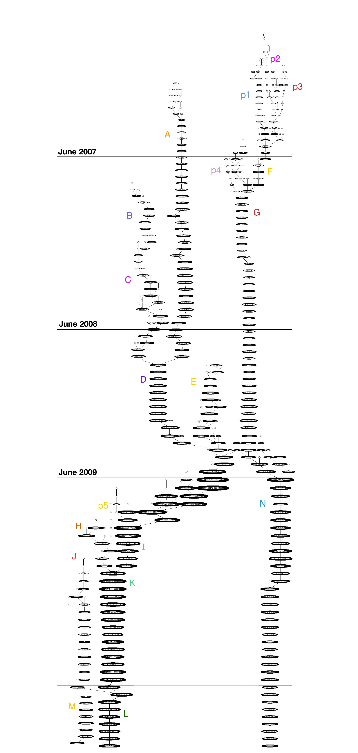
G: Iran’s foreign affairs: nuclear talks, US, Russia, Europe, Iraq, and the Israeli-Palestinian conflict. Highly concentrated on major news agencies outside Iran (especially the BBC Persian).
B: Articles published by conservative fundamentalist websites.
The Green Movement
Massive protests and their subsequent violent crackdown coincide with a major change in dynamics of the site
N: Articles about human rights violations committed against the protesters by the government and the arrests of activists.
I, K, L: Large pro-Green Movement consecutive paths. YouTube videos of protests and eyewitness accounts are the focal points.
J: Against prominent reformist figures.
Notes:
Now here is the overall map, now with interpretations of summaries we have found.
Fully automated and has No human intervention.
A-G before election, H-N after
Any questions?
(Add numbers)

Slide 21
User Retention
Paths with high retention: G, N, K
Paths with low retention: B, C, E, J, H
Notes:
We will evaluate the paths and characterize them
Paths with high retention: G (foreign affairs), N (human rights), K(eyewitness)
Paths with low retention: B&C(conservative), E(sarcastic), J (anti reformist), H(sensational)

Slide 22
Domain Recurrence
Are some domains repeatedly preferred in a path?
Aggregate domains over whole path and count their recurrence
Compare with count of domains if the votes were drawn at random
Draw votes at random and note their domains
Higher relative recurrence = more uniformity in domains
p_{i} : Probability that an article from domain i is in the top n most preferred articles of a path.
Paths with high recurrence: B(conservative), G(foreign affairs), K(eyewitness)
Notes:
n = ?

Slide 23
Principal Component Analysis Corroborates Path Meanings
PCA plot of core-user overlaps
A temporal and a political dimension emerge as a result of PCA analysis on user overlaps in paths.
First two components explain 43% of variance
Contents of paths agree with path positions in the PCA political dimension.
Notes:
The two scales
Remove the time and politics in paranthesis. Animate instead
With no human intervention, it has strucutres in it.
----- Meeting Notes (8/27/13 14:05) -----
change

Slide 24
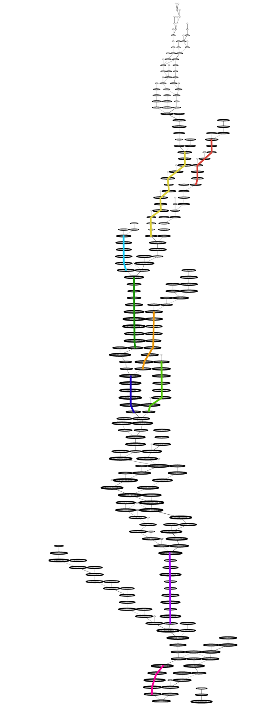
Alternative dataset: sports
Method is applicable to different contexts
Found that Sports is highly event-driven with some early adopters for each event, joined by the rest some periods later:
Asian (soccer) cup
National leagues
European cup
Paralympics
National soccer gossip
Notes:
This methodology is applicable to other contexts
Affected by political upheaval
6-7 months with no clear paths
www.farsnews.com before and after election

Slide 25
Gestalt Computing
A macro structure
Constructed from elementary user actions
More than sum of its parts:
Relationship between parts of the structure.
What is not there as well as what is there.
Current methods:
partial snapshots of structures in the data
either fine-grained or too general.
What is missing: a framework that provides an overall picture and allows exploration → a gestalt framework
We began with elementary actions (votes) → obtained global structure → the context in the structure gives back meaning to individual actions
From the Merriam-Webster dictionary: Gestalt is a structure, configuration, or pattern of physical, biological, or psychological phenomena so integrated as to constitute a functional unit with properties not derivable by summation of its parts.
Gestalt principle in Design
Notes:
This can be called gestalt computing, now let’s go over what it is.
Actions are revealing. The parts created the whole but the whole adds meaning to the parts.
Alternatively what could we have done? it cannot answer the questions of this kind

Slide 26
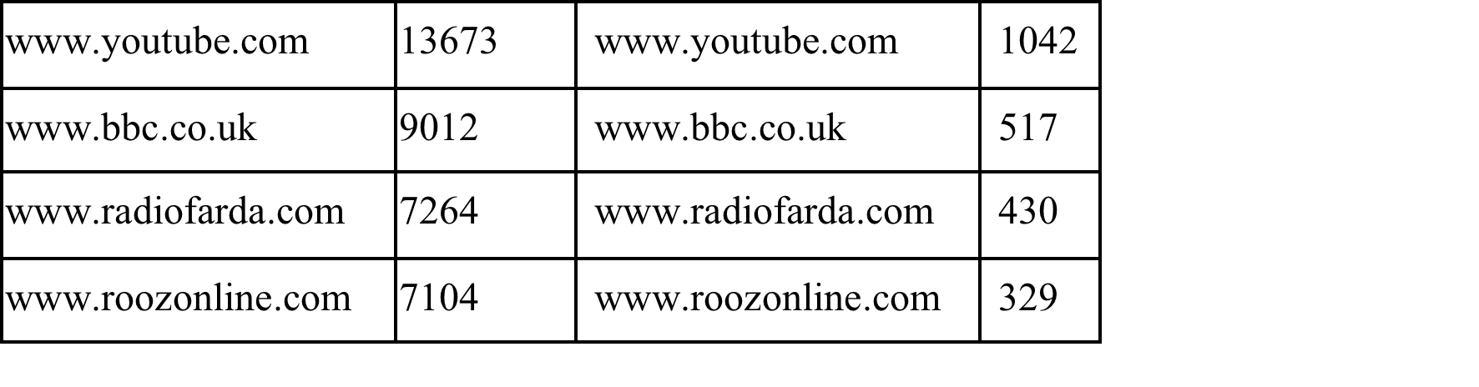
Structure Reveals a New Perspective
Comparing two users: 2 of their top 20 domains are different.
User 1 Consistency: 3.75
Core users in paths A, F, G, N: Reformist, Foreign affairs, Human rights.
User 2 Consistency: 0.6
Core user in paths A, C, D, G, K, L, N: Reformist, Weakly conservative, Anti-Ahmadinejad, Foreign affairs, Eyewitness, Human rights.
Number of active periods
Number of path switches
Number of unique paths

Slide 27
Benefit of a Gestalt Approach
Automated and unsupervised
Paths with distinct and meaningful preferences.
Incorporates both users and content (vs. just one)
Data driven (no priors) and less computationally intensive
Arranging in layers allows for both high-level and fine-grained inspection of dynamics over time
Articles, urls, words for each community at each time
URLs and words for each path
Users in each community (pagerank)
One can ask further questions using this global picture
Reveals a new perspective otherwise unknown
Notes:
Since this is a defense presentation, I’d like to go to other topics that comprise my thesis, these are more in the traditional way. For the sake of completeness.

Slide 28
Concluding Remarks
We proposed a Gestalt approach: Reveals a new perspective otherwise unknown
Automated and unsupervised method produced paths with distinct and meaningful preferences.
Questions:
Does a gestalt approach sacrifice complexity and sophistication?
Is this the “single” “True” structure?
Can one combine user actions with different/multiple/undefined intentions?
Ethical considerations: surveillance and privacy
Future direction
Collaboration with social scientists
Developing further global metrics
Creative evaluation methods are needed
Notes:
Use on other contexts and datasets
Further studies on choice of parameters

Slide 29
Experiments
Corpus | Cafemom threads | NSF abstracts | Reuters news | Twitter tweets
The number of documents | 139,455 | 132,371 | 297,141 | 2,665,947
Size of vocabulary | 24,389 | 11,829 | 22,141 | 11,304
The number of tokens | 521,888,703 | 15,267,732 | 36,363,812 | 19,693,219
Notes:
To evaluate our topic assignment using associative networks, we applied our inference algorithms on four large scale datasets of different genre. Table 5.2 summarizes the size of document, the size of vocabulary, and number of tokens in each dataset. Cafemom is a online social forum where young mothers discuss different issues about parenting and their children and we consider a whole thread with all the posts as a document. The National Science Foundation datasets are a collection of NSF funding abstracts, which represent the corpus of scientific abstract. The Reuters datasets are a collection of various news, from politics, science, finance to sports. Lastly, 2009 Iran post-election tweets is a collection of short texts from online microblogging system Twitter.

Slide 30
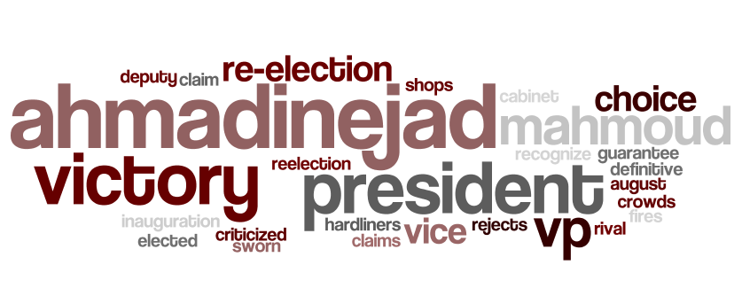
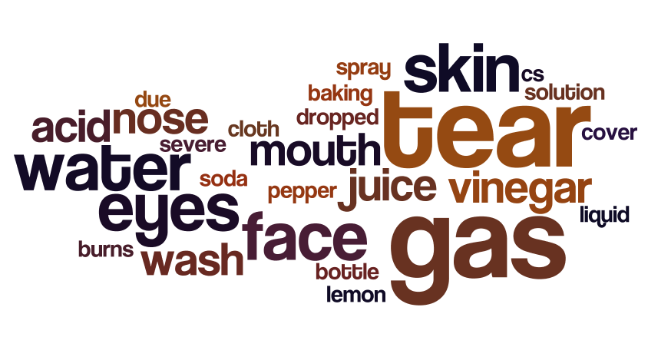
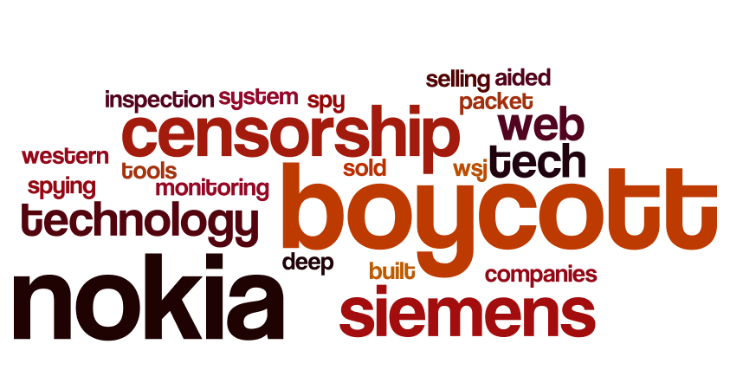

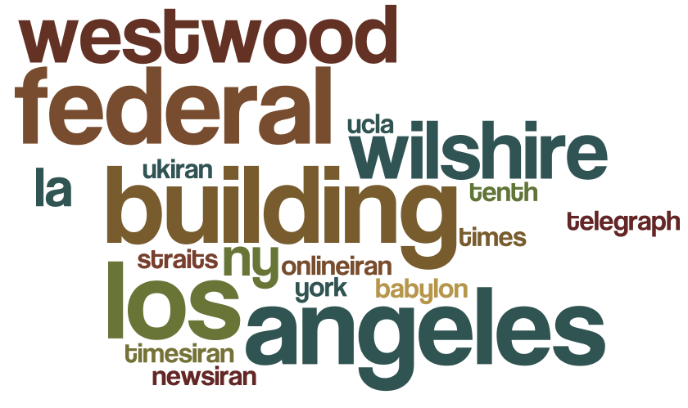
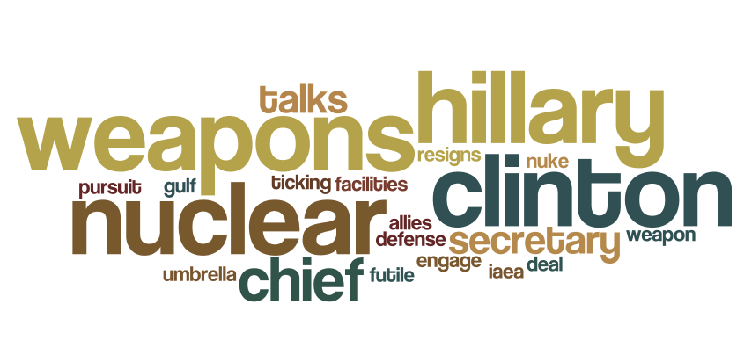
Topic Extraction
…
…

Slide 31
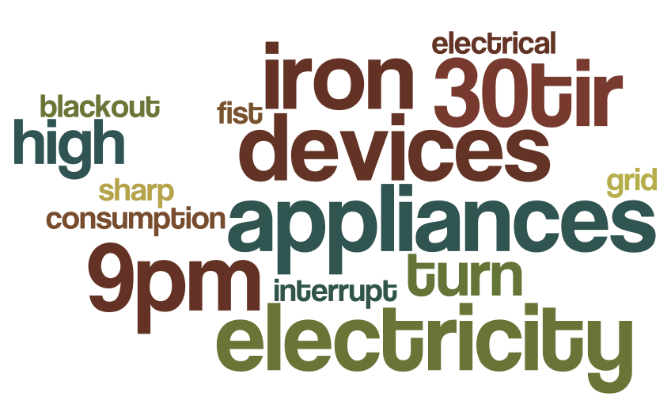
Topic and Event Case
Event: United effort to create a blackout during Ahmadinejad’s speech broadcast by consuming huge impulsive power
Drive: People [re-]tweeted calls for action telling others to turn on power-consuming appliances at exactly the same time

Slide 32
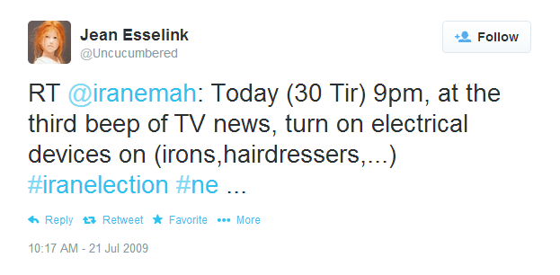
Event and Tweets
Tweets are mapped to a certain topic based on related terms and how likely the combination of words refers to the topic
Ability to find tweets about an “event” with different wordings

Slide 33
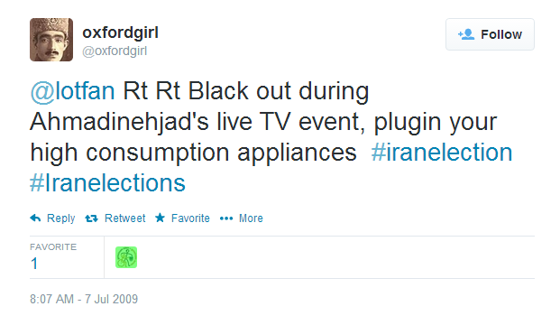
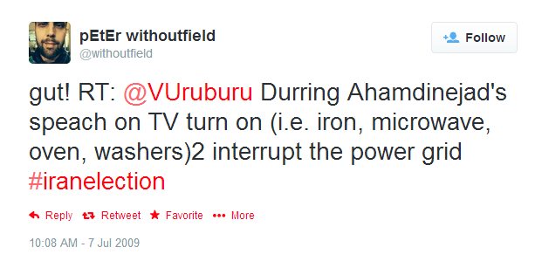
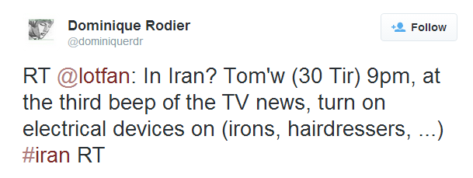
Event and Tweets
Call for Blackout
The trend of particular events can be traced
Key players can be identified

